Slide 1
Data Structures and Algorithms -3 (25CS2103E)
Intelligent Multilingual Knowledge Discovery Platform
Team Members
G.Neha 2520030068
D. Shreenitha 2520030504
A.Srihitha 2520030566
Under the Esteemed Guidance of
Name of the DSA-3 faculty name with designation and department

Slide 2
Contents
Abstract
Introduction
Literature survey
Problem Statement and Objectives
Hardware and Software requirements
Results
Conclusion
Future Scope

Slide 3
Abstract
BharatWiki AI is an AI-powered multilingual knowledge discovery platform designed to provide fast and relevant information from Indian-language Wikipedia content. The system initially supports Hindi, Telugu, Tamil, and Kannada. Wikipedia data is collected, cleaned, normalized, and indexed to make searching efficient. Apache Lucene is used as the search engine, while TF-IDF and BM25 algorithms are used to rank results based on relevance. The platform supports single-keyword, multiple-keyword, and multilingual searches. NLP and AI techniques are used to provide semantic search, AI-generated summaries, related-article recommendations, keyword highlighting, and search suggestions. React is used for the frontend, Java Spring Boot for the backend, and PostgreSQL for database management. An analytics dashboard provides information about search trends, popular topics, language distribution, and response time. The main objective of BharatWiki AI is to make knowledge discovery faster, easier, and more useful for Indian-language users while demonstrating the practical use of AI, NLP, information retrieval, and multilingual computing.

Slide 4
Introduction
BharatWiki AI – Intelligent Multilingual Knowledge Discovery Platform is a multilingual search system designed to help users efficiently find information from Indian-language content. The project focuses on languages such as Hindi, Telugu, Tamil, and Kannada. It uses NLP techniques including text cleaning, Unicode normalization, tokenization, and stop-word removal to process the data. An Inverted Index is used as the main data structure for fast document retrieval, while TF-IDF and BM25 techniques are used to rank search results based on relevance. The platform aims to make multilingual knowledge discovery faster, efficient, and more accessible to users.

Slide 5
Literature Survey
No. | Research Paper | Authors | Year | Relation to Your Project
1 | Cross-Lingual Information Retrieval System for Indian Languages | Jagadeesh Jagarlamudi, A. Kumaran | 2008 | Indian-language information retrieval
2 | Exploiting Wikipedia for Cross-Lingual and Multilingual Information Retrieval | Research on Wikipedia-based multilingual IR | 2012 | Uses Wikipedia as a multilingual knowledge resource
3 | Exploiting Wikipedia API for Hindi-English Cross-language Information Retrieval | Researchers in CLIR | 2016 | Hindi-English search using Wikipedia and BM25
4 | Towards Building a Multilingual Semantic Network: Identifying Interlingual Links in Wikipedia | Bharath Dandala, Rada Mihalcea, Razvan Bunescu | 2012 | Semantic relationships between Wikipedia languages
5 | WikiTranslate: Query Translation for Cross-lingual Information Retrieval using only Wikipedia | Dong Nguyen et al. | — | Uses Wikipedia for multilingual query translation
6 | Analysing Entity Context in Multilingual Wikipedia to Support Entity-Centric Retrieval Applications | Yiwei Zhou, Elena Demidova, Alexandra I. Cristea | 2016 | Multilingual Wikipedia and entity-based retrieval
7 | Considerations for Multilingual Wikipedia Research | Isaac Johnson, Emily Lescak | 2022 | Challenges and considerations when using multilingual Wikipedia datasets
8 | SqCLIRIL: Spoken Query Cross-Lingual Information Retrieval in Indian Languages | Bhargav Dave, Prasenjit Majumder | 2026 | Indian-language retrieval using BM25, semantic retrieval, and AI-based ranking

Slide 6
Problem Statement and Objectives
Problem Statement
Searching through large amounts of multilingual Wikipedia content can be time-consuming. Traditional keyword search may not provide intelligent results, summaries, or related information. BharatWiki AI aims to provide fast, relevant, and intelligent knowledge discovery across Indian-language Wikipedia content.
Objectives
•Provide multilingual search for Indian languages
•Improve search speed using an inverted index
•Rank results using TF-IDF and BM25
•Support semantic search using NLP/AI
•Generate AI-based summaries
•Recommend related articles

Slide 7
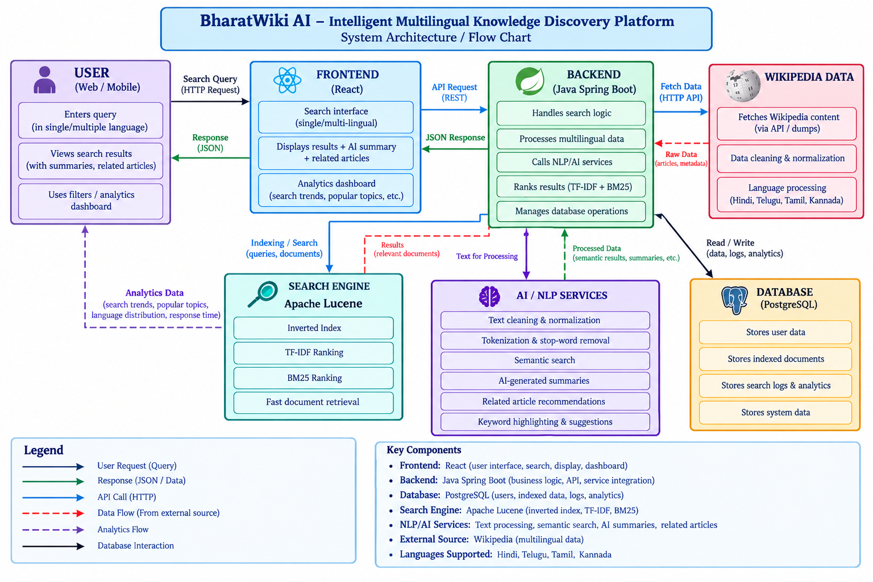
Flow Chart

Slide 8
Results
For your Intelligent Multilingual Knowledge Discovery Platform, you can put these points on the Results slide:
Accurate Information Retrieval – Retrieves relevant knowledge from multilingual sources such as Wikipedia
Multilingual Search – Supports searching and discovering information across different languages
Improved Result Ranking – Combines BM25 and semantic retrieval to identify more relevant results
Cross-Lingual Query Processing – Allows users to search in one language and retrieve information from content available in another
Semantic Understanding – Identifies results based on meaning, not only exact keyword matches
Knowledge Discovery – Provides users with relevant and organized information from multiple language resources
Efficient Retrieval – Reduces the effort required to find information across multilingual knowledge bases
For your Intelligent Multilingual Knowledge Discovery Platform, you can put these points on the Results

Slide 9
Hardware and Software requirements
Hardware Requirements | Software Requirements
Processor: Intel Core i5 or equivalent | Operating System: Windows / Linux
RAM: 8 GB minimum | Programming Language: Python
Storage: 256 GB SSD or higher | IDE: VS Code / Jupyter Notebook
GPU: Optional | Libraries: NLTK, Scikit-learn, Transformers
Internet Connection: Required | Retrieval: BM25 / Semantic Search
Microphone: Required for voice queries (optional) | Knowledge Source: Wikipedia / Wikipedia API
Display: Standard monitor | Database/Storage: Suitable document or vector storage

Slide 10
Conclusion
Conclusion
The Intelligent Multilingual Knowledge Discovery Platform enables users to search and discover information across multiple languages
It combines query processing, multilingual retrieval, BM25, and semantic search to identify relevant information
The platform helps overcome language barriers and improves access to knowledge from multilingual sources such as Wikipedia
It provides relevant and user-friendly information in the user's preferred language

Slide 11
Future Scope
Future Scope
Add advanced voice and speech-based search for Indian languages
Integrate Generative AI/LLMs for better answers and automatic summarization
Support more Indian and international languages
Improve semantic understanding using advanced multilingual embedding models
Develop a mobile application for easier access
Expand the knowledge base beyond Wikipedia to include books, research papers, news, and educational resources
Implement real-time retrieval and personalized recommendations

Slide 12
Thank you

